Slide 1
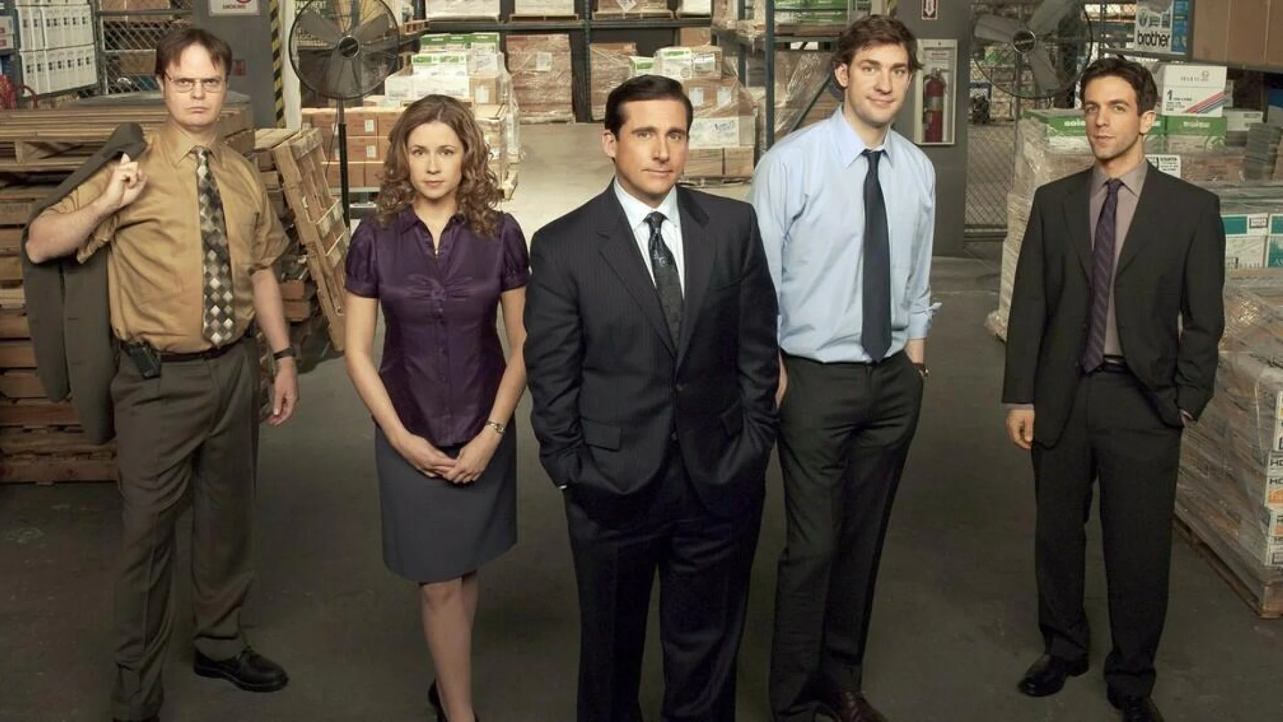

Classification of Quotes
Babiak Chiara
Führer Angelika
Rinner Clemens

Slide 2
Main Goal
Classify given The Office Quotes by
main characters
Micheal
Dwight
Jim
Pam

Slide 3
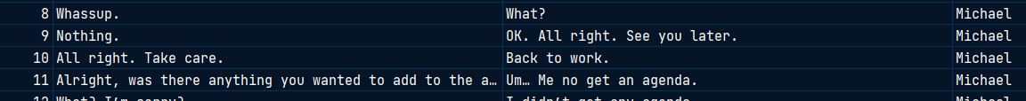
Dataset
Kaggle
https://www.kaggle.com/datasets/chazzer/the-office-quotes-dataset
parent.csv (26150)
talking_head.csv (1749)
“Am I going to tell them? No, I am not going to tell them. I don’t see the point of that. As a doctor, you would not tell a patient if they had cancer.” - Michael

Slide 4
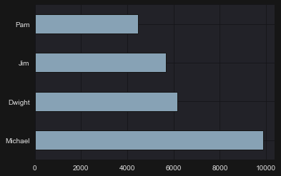
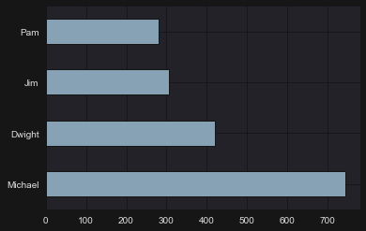
Dataset

Slide 5
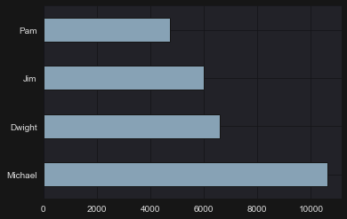
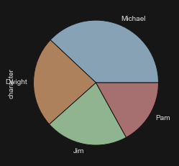
Merged Data

Slide 6

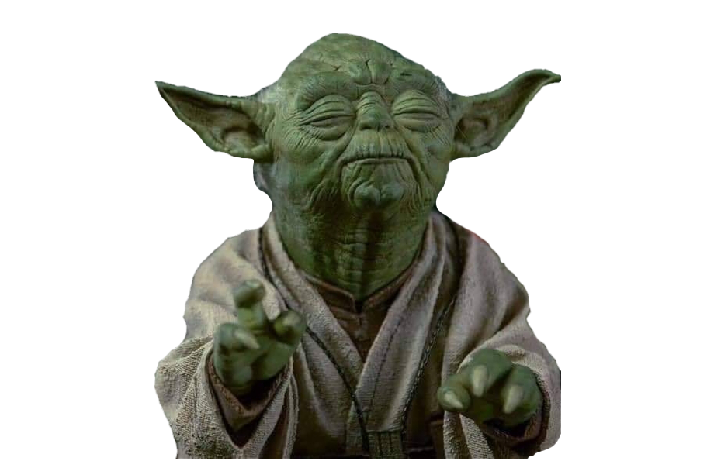
Preprocessing
1. Tokenization
2. Lower Casing
3. Stop Word Removal
4. Stemming
5. Lemmatization
Result:
“So you’ve come to the master for guidance? Is this what you’re saying, grasshopper?”
“come master guidance say grasshopp”

Slide 7
Code/Models

